Slide 1
REAL ESTATE ANALYSIS
GROUP 3
PRESENTED BY-
ABHAY BILAPATTE
AKSHAY G BHAT
ANUKA MYTHRI
REEBA SAHAB
SAURABH JAISWAL
TEJASWI KADAM

Slide 2

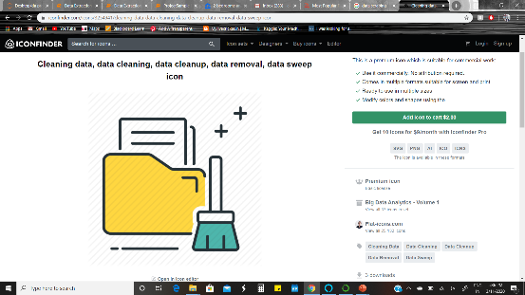
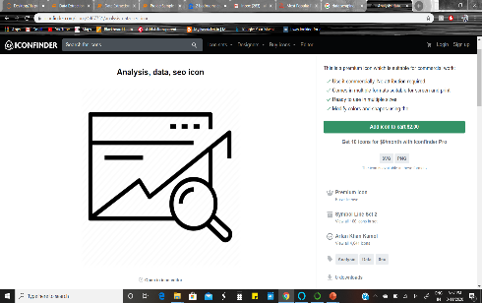
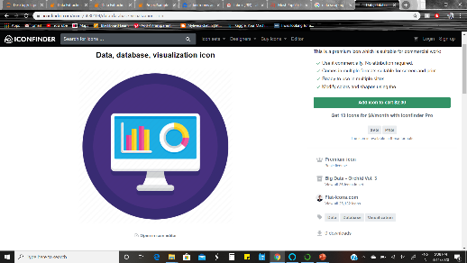
APPROACH
DATA SCRAPING
DATA CLEANING
DATA VISUALISATION
DATA ANALYSIS

Slide 3
PROCESS
ANALYZE
Here we perform a detailed analysis of the results
obtained
VISUALISE
Here we used various visualization techniques to analyze our data
CLEAN
Here we cleaned up our data by handling missing data, removing data type constraints etc.
SCRAPE
Here we scraped multiple ZILLOW pages as per our requirement

Slide 4
ATTRIBUTES
ATTRIBUTES
STREET
CITY
TYPE
LINKS
SOLDPRICE
YEAR BUILT
SQ.FT
CITY
BED $ BATH
ADDRESS
HEATING TYPE
COOLING TYPE
PRICE
VARIATION
ZESTIMATE
STYLE
ANNUAL
TAX
VALUE
SCHOOL
DISTANCE
ZESTIMATE
MIN
ZESTIMATE
MAX
TAX
ASSESSED
VALUE

Slide 5

PA
PART-1
DATA SCRAPING

Slide 6
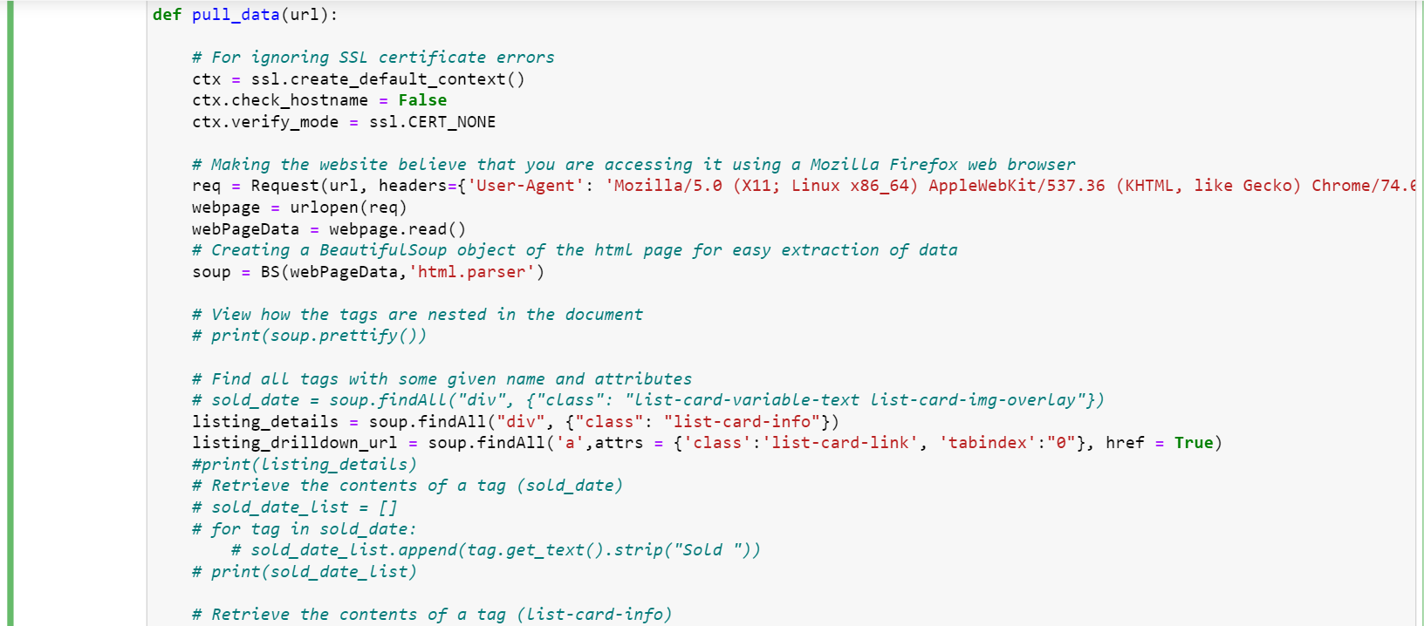

Slide 7
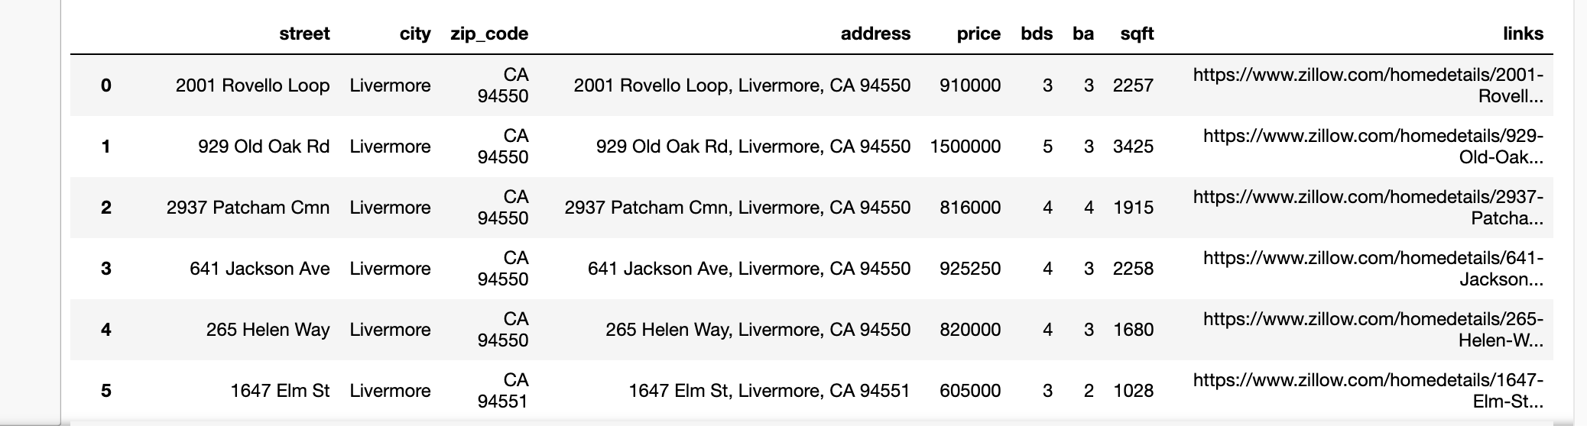
Result of First Function

Slide 8
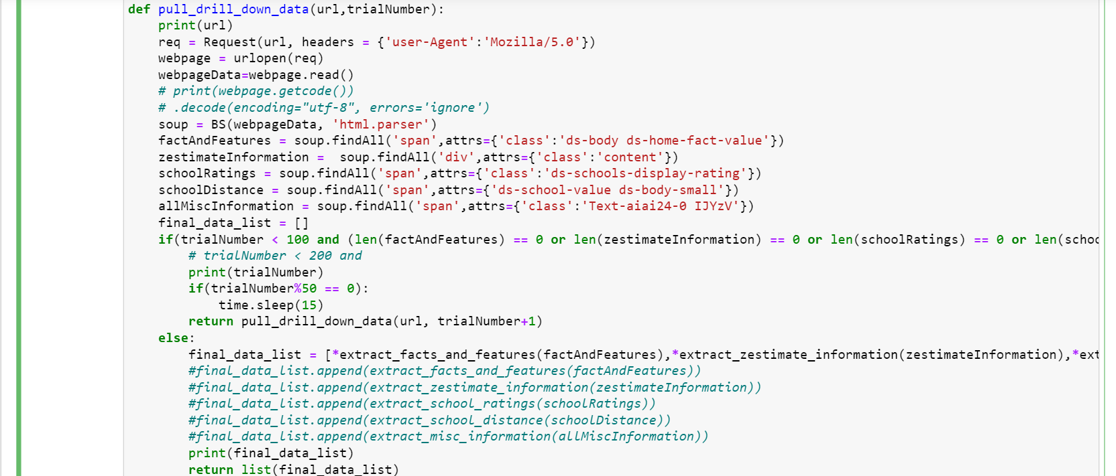

Slide 9
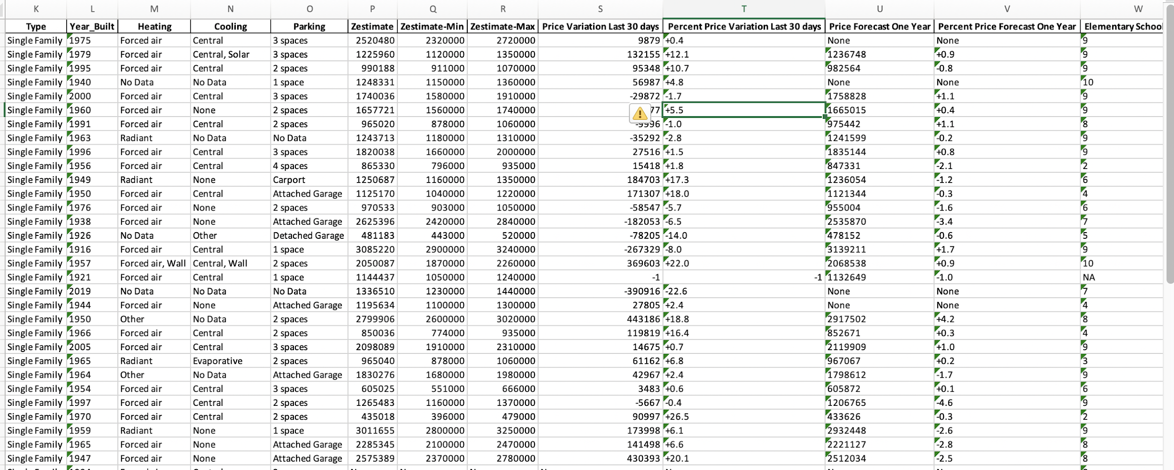
Function 2 Additional Data

Slide 10
PA
PART-2
DATA CLEANING

Slide 11
PRIORITY-
1] SCRAPING OUT IRRELEVANT DATA
2] VALUE CONVERSIONS AS PER OUR REQUIREMENT.
3] CHECKING FOR NULL VALUES

Slide 12
CHALLENGES FACED
FETCHING DATA USING API
FETCHING INTERNAL DATA
NULL DATA MANAGEMENT

Slide 13
Analysis 1
Sold Price VS Zestimate

Slide 14
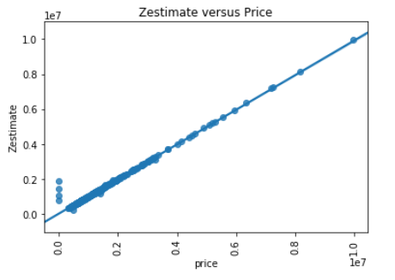
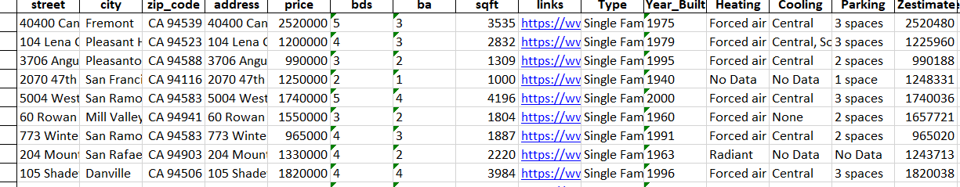

Slide 15
Analysis 2
HOT SPOTS

Slide 16
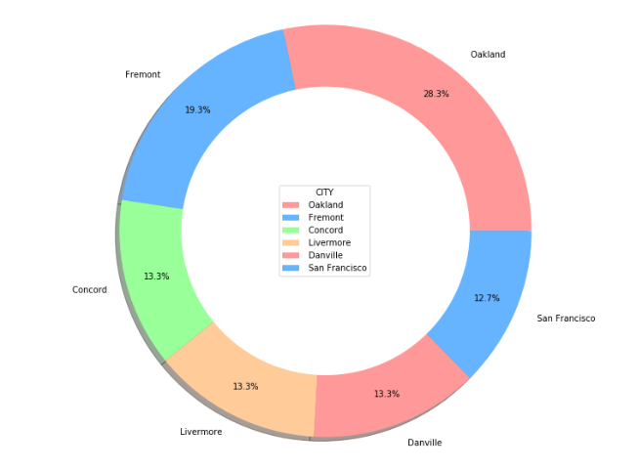
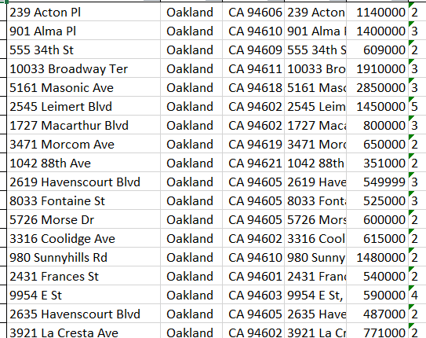

Slide 17
INFERENCE
01
OAKLAND STANDS OUT AS A FAVOURITE CHOICE
02
CONCORD STANDS LAST

Slide 18
Analysis 3
MAX,MIN $ MEAN PRICE

Slide 19
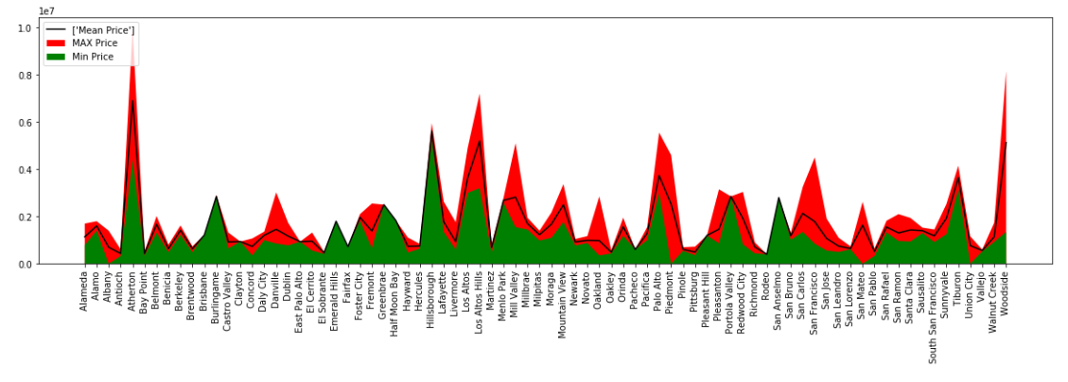

Slide 20
INFERENCE
01
NO MUCH RANGE DIFFERENCE IN FEW CITIES
EVEN NON-POPULAR CITIES HAVE PROPERTIES SOLD AT HIGH RANGE
02

Slide 21
Analysis 5
YEAR BUILT VS FREQ OF HOUSES
SOLD

Slide 22
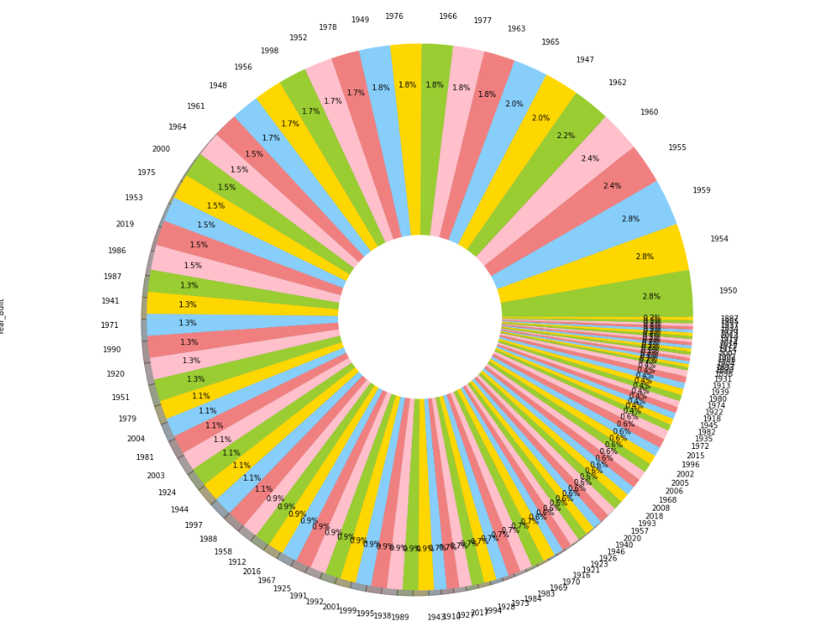

Slide 23
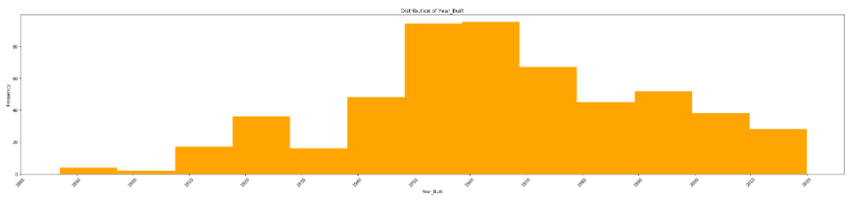

Slide 24
Analysis 6
PRICE VS SQ.FT

Slide 25
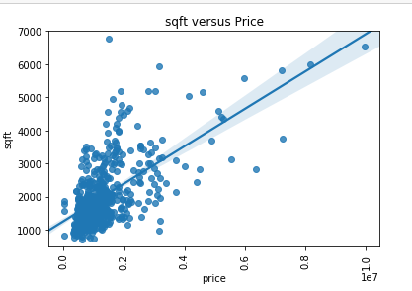

Slide 26
THANK YOU!!

